Slide 1
CS2006 Operating Systems
SPRING 2023
National University of Computer and Emerging Sciences

Slide 2
Chapter 4
Threads and concurrency

Slide 3
Process Concept
Classically, processes are executed programs that have ...
Resource Ownership
Process includes a virtual address space to hold the process image
Operating system prevents unwanted interference between processes
Scheduling/Execution
Process follows an execution path that may be interleaved with other processes
Process has an execution state (Running, Ready, etc.) and a dispatching priority and is scheduled and dispatched by the operating system
Today, the unit of dispatching is referred to as a thread or lightweight process
The unit of resource ownership remains the process or task
3

Slide 4
Process creation is time consuming and resource intensive, however. If the new process will perform the same tasks as the existing process, why incur all that overhead?
It is generally more efficient to use one process that contains multiple threads
Most operating system kernels are also typically multithreaded.
As an example, during system boot time on Linux systems, several kernel threads are created. Each thread performs a specific task, such as managing devices, memory management, or interrupt handling
Most software applications that run on modern computers and mobile devices are multithreaded
An application typically is implemented as a separate process with several threads of control

Slide 5
Control Blocks
Information associated with each process: Process Control Block
Memory management information
Accounting information
Information associated with each thread: Thread Control Block
Program counter
CPU registers
CPU scheduling information
Pending I/O information
5

Slide 6
Process ID (PID)
Parent PID
…
Next Process Block
PCB
List of open ﬁles
Handle Table
Image File Name
Thread Control Block (TCB)
List of Thread Control Blocks
…
Next TCB
Program Counter
Registers
…

Slide 7
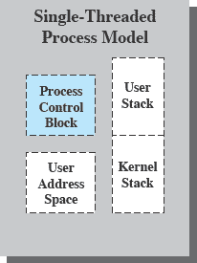
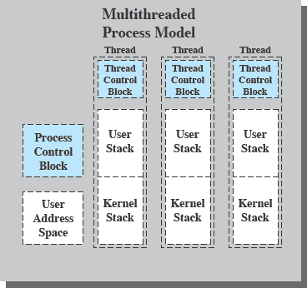
Single & Multithreading Process
Each thread has
An execution state (Running, Ready, etc.)
Saved thread context when not running
An execution stack
Some per-thread static storage for local variables
Access to the memory and resources of its process (all threads of a process share this)
Suspending a process involves suspending all threads of the process
Termination of a process terminates all threads within the process
6
PT / FF 2014

Slide 8
Why Multithreading?
Advantages
Better responsiveness - dedicated threads for handling user events
Simpler resource sharing - all threads in a process share same address space
Utilization of multiple cores for parallel execution
Faster creation and termination of activities
Disadvantages
Coordinated termination
Signal and error handling
Reentrant vs. non-reentrant system calls: reentrant if it can be interrupted in the middle of its execution, and then be safely called again

Slide 9
Thread States
The typical states for a thread are running, ready, blocked
Typical thread operations associated with a change in thread state are:
Spawn: a thread within a process may spawn another thread
Provides instruction pointer and arguments for the new thread
New thread gets its own register context and stack space
Block: a thread needs to wait for an event
Saving its user registers, program counter, and stack pointers
Unblock: When the event for which a thread is blocked occurs
Finish: When a thread completes, its register context and stacks are deallocated.

Slide 10
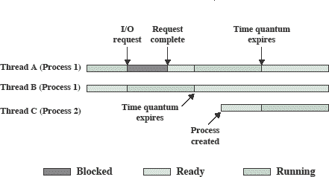

Slide 11
Thread Dispatching
Thread T₁
Interrupt or system call
Thread T₂
executing
Save state into TCB₁
ready or waiting
Reload state from TCB₂
Interrupt or system call
ready or waiting
executing
Save state into TCB₂
Reload state from TCB₁
ready or waiting
executing

Slide 12
Threads
Threads share….
Thread specific attributes
Global memory
Process ID and parent process ID
Controlling terminal
Process credentials (user )
Open file information
Timers
………
Thread ID
Thread specific data
CPU affinity
Stack (local variables and function call linkage information)
……

Slide 13
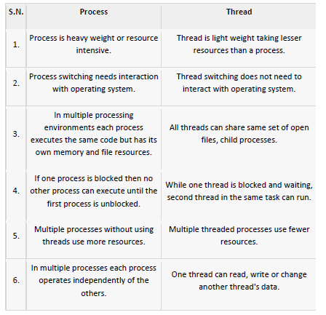

Slide 14
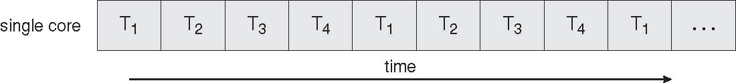
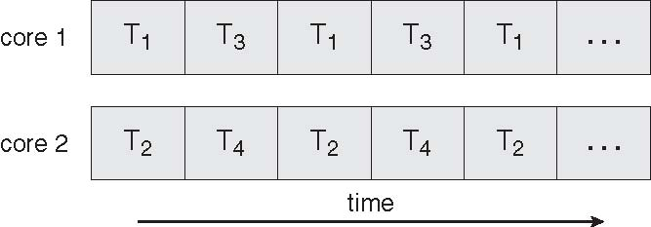
Concurrent Execution on a Single-core System
Parallel Execution on a Multicore System

Slide 15
Multicore Programming
Multicore systems putting pressure on programmers, challenges include
Dividing activities
What tasks can be separated to run on different processors
Balance
Balance work on all processors
Data splitting
Separate data to run with the tasks
Data dependency
Watch for dependences between tasks
Testing and debugging
Harder!!!!

Slide 16
Types of Parallelism
Data Parallelism: focus on distributing data across different parallel computing nodes
Task Parallelism: focus on distributing execution processes(threads) across different parallel computing nodes

Slide 17
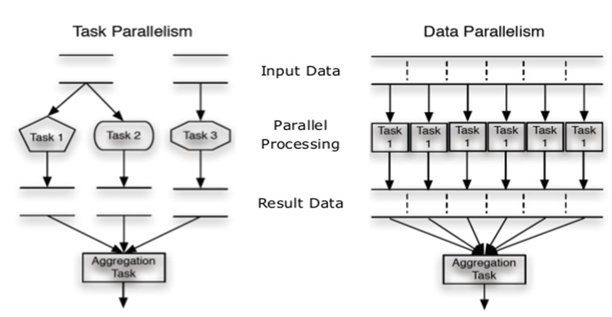

Slide 18
Data vs. Task Parallelism
Data Parallelism | Task Parallelism
Same operations are performed on different subsets of same data. | Different operations are performed on the same or different data.
Synchronous computation | Asynchronous computation
Speedup is more as there is only one execution thread operating on all sets of data. | Speedup is less as each processor will execute a different thread or process on the same or different set of data.
Amount of parallelization is proportional to the input data size. | Amount of parallelization is proportional to the number of independent tasks to be performed
Designed for optimum load balance on multi processor system. | Load balancing depends on the availability of the hardware and scheduling algorithms like static and dynamic scheduling.

Slide 19
Amdahl’s Law
Amdahl's law is an expression used to find the maximum expected improvement to an overall system when only part of the system is improved.
It is often used in parallel computing to predict the theoretical maximum speedup using multiple processors

Slide 20

Amdahl’s Law
Amdahl's law is used in parallel computing to predict the theoretical speedup when using multiple processors
Where
S = portion of program executed serially
N = Processing Cores

Slide 21
Amdahl’s Law Example
we have an application that is 75 percent parallel and 25 percent serial. If we run this application on a system with two processing cores?
S=25%=0.25, N= 2
If we add two additional cores , calculate speedup?

Slide 22
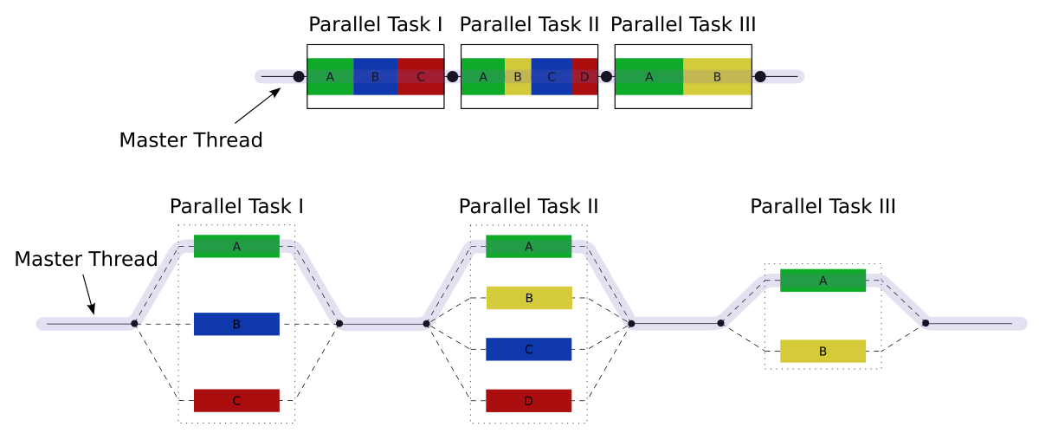
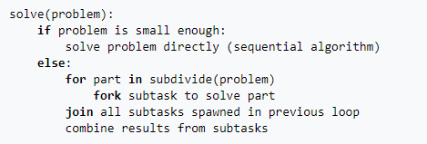
Fork – Join Model

Slide 23
Multithreading Models
Support provided at either:
User level -> user threads
Supported above the kernel and managed without kernel support
Kernel level -> kernel threads
Supported and managed directly by the operating system
What is the relationship between user and kernel threads?

Slide 24
User Threads
Thread management done by user-level threads library
Three primary thread libraries:
POSIX Pthreads
Win32 threads
Java threads

Slide 25
Kernel Threads
Supported by the Kernel
Examples
Windows XP/2000
Solaris
Linux
Tru64 UNIX
Mac OS X

Slide 26
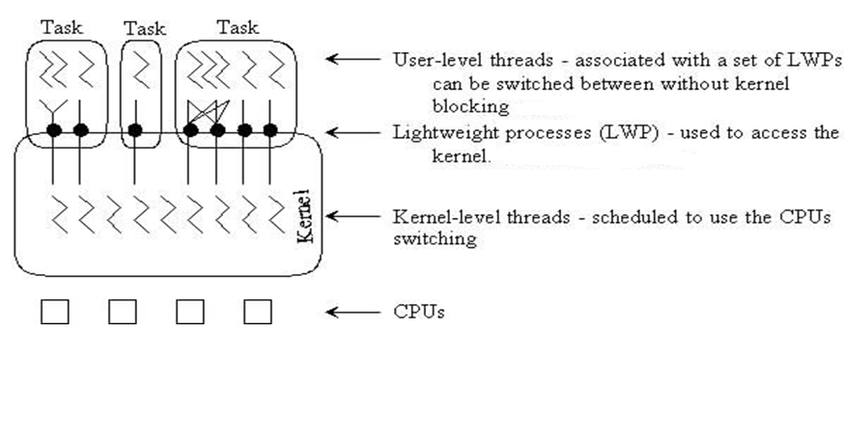
User vs. Kernel Thread

Slide 27
Multithreading Models
Many-to-One
One-to-One
Many-to-Many
User Thread – to - Kernel Thread

Slide 28
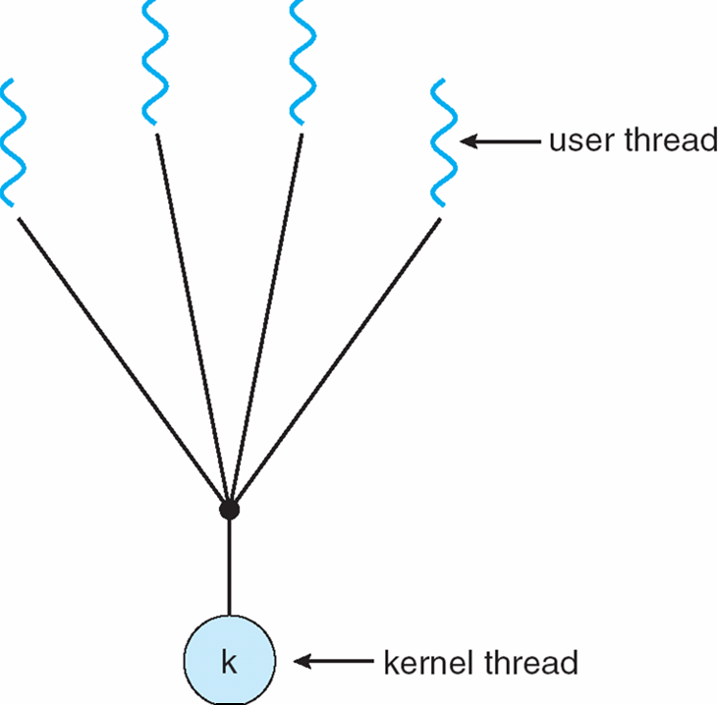
Many-to-One
Many user-level threads mapped to single kernel thread
Only one thread can access the kernel at a time,
multiple threads are unable to run in parallel on multicore systems.
the entire process will block if a thread makes a blocking system call

Slide 29
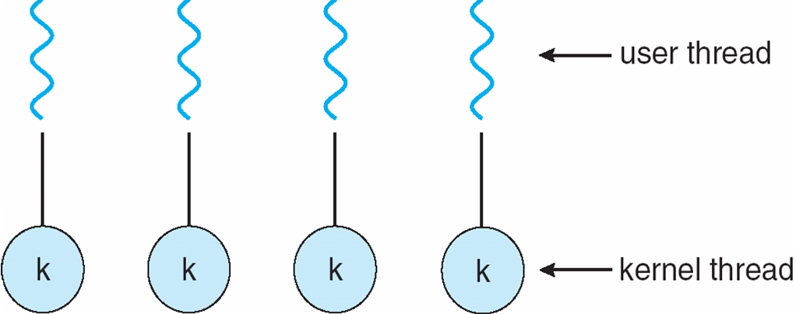
One-to-One
Each user-level thread maps to kernel thread
more concurrency than the many-to-one model by allowing another thread to run when a thread makes a blocking system call.
Allows multiple threads to run in parallel on multiprocessors.
drawback is, creating a user thread requires creating the corresponding kernel thread and a large number of kernel threads may burden the performance of a system.

Slide 30
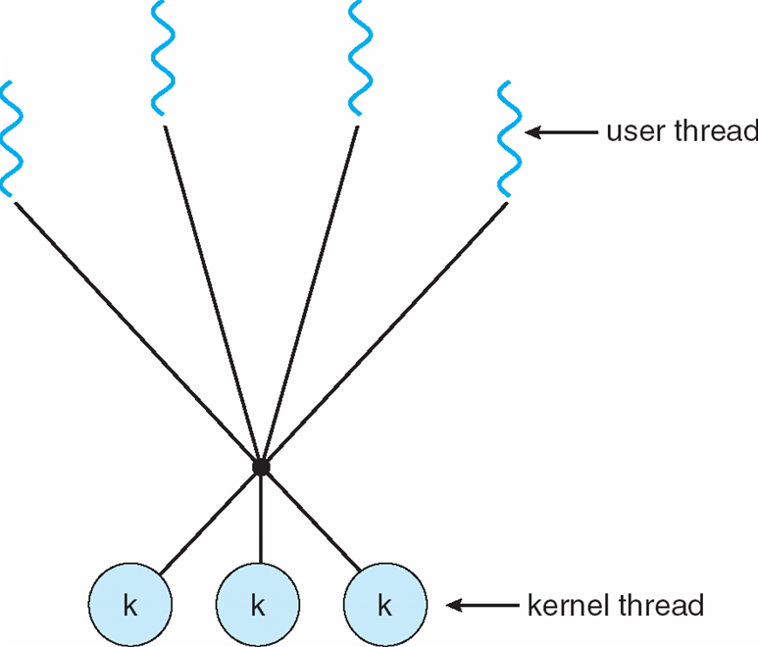
Many-to-Many Model
multiplexes many user-level threads to a smaller or equal number of kernel threads
developers can create as many user threads as necessary, and the corresponding
kernel threads can run in parallel on a multiprocessor.
When thread performs a blocking system call, the kernel can schedule another thread for
execution.

Slide 31
Thread Libraries
A thread library provides the programmer with an API for creating and managing threads.
There are two primary ways of implementing a thread library:
The first approach is to provide a library entirely in user space with no kernel support.
This means that invoking a function in the library results in a local function call in user space and not a system call.
The second approach is to implement a kernel-level library supported directly by the operating system.
In this case, code and data structures for the library exist in kernel space. Invoking a function in the API for the library typically results in a system call to the kernel.

Slide 32
Thread Libraries
Three main thread libraries in use today:
POSIX Pthreads
May be provided either as user-level or kernel-level
A POSIX standard (IEEE 1003.1c) API for thread creation and synchronization
API specifies behavior of the thread library, implementation is up to development of the library
Win32
Kernel-level library on Windows system
Java
Java threads are managed by the JVM
Typically implemented using the threads model provided by underlying OS

Slide 33
POSIX Compilation on Linux
On Linux, programs that use the Pthreads API must be compiled with
–pthread or –lpthread
gcc thread.c –pthread –o thread

Slide 34
POSIX: Thread Creation
int pthread_create(pthread_t *thread, const pthread_attr_t *attr, void *(*start)(void *), void *arg);
*thread Is the location where the ID of the newly created thread should be stored, or NULL if the thread ID is not required.
attr Is the thread attribute object specifying the attributes for the thread that is being created. If attr is NULL, the thread is created with default attributes.
start Is the main function for the thread; the thread begins executing user code at this address.
arg Is the argument passed to start.

Slide 35
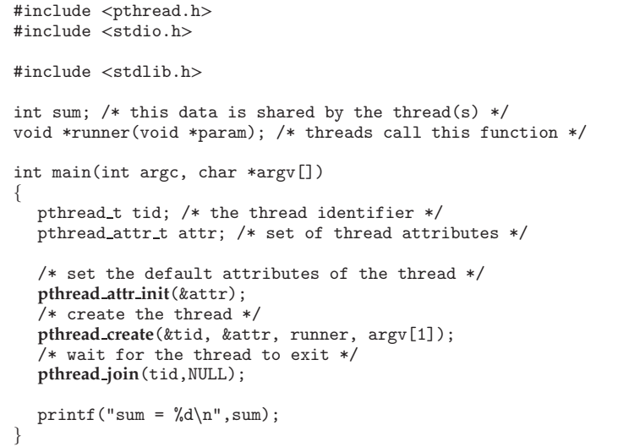

Slide 36
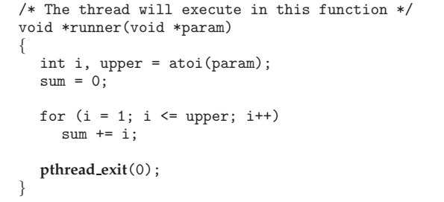

Slide 37
Thread Basics: Creation and Termination
#include <pthread.h>
// A normal C function that is executed as a thread
// when its name is specified in pthread_create()
void *myThreadFun(void *vargp)
{
sleep(1);
printf("Printing GeeksQuiz from Thread \n");
return NULL;
}
int main()
{
pthread_t thread_id;
printf("Before Thread\n");
pthread_create(&thread_id, NULL, myThreadFun, NULL);
pthread_join(thread_id, NULL);
printf("After Thread\n");
exit(0);
}

Slide 38
In main() we declare a variable called thread_id, which is of type pthread_t, which is an integer used to identify the thread in the system.
After declaring thread_id, we call pthread_create() function to create a thread. pthread_create() takes 4 arguments
The first argument is a pointer to thread_id which is set by this function.
The second argument specifies attributes. If the value is NULL, then default attributes shall be used.
The third argument is name of function to be executed for the thread to be created.
The fourth argument is used to pass arguments to the function, myThreadFun

Slide 39
A call to pthread_join waits for the termination of the thread whose id is given by thread_id.
On a successful call to pthread_join, the value passed to pthread_exit is returned in the location pointed to by the second argument.
On successful completion, pthread_join returns 0, else it returns an error-code.

Slide 40
POSIX: Thread ID
The pthread_self() function returns the ID of the thread in which it is invoked.

Slide 41
// C program to demonstrate working of pthread_self()
#include <stdio.h>
#include <stdlib.h>
#include <pthread.h>
void* calls(void* ptr)
{
// using pthread_self() get current thread id
printf("In function \nthread id = %d\n", pthread_self());
pthread_exit(NULL);
return NULL;
}
int main()
{
pthread_t thread; // declare thread
pthread_create(&thread, NULL, calls, NULL);
printf("In main \nthread id = %d\n", thread);
pthread_join(thread, NULL);
return 0;
}

Slide 42
POSIX: Wait for Thread Completion
pthread_join: used to wait for the termination of a thread.
Syntax:
int pthread_join(pthread_t th, void **thread_return);
Parameter: This method accepts following parameters:
th: thread id of the thread for which the current thread waits.
thread_return: pointer to the location where the exit status of the thread mentioned in th is stored.

Slide 43
POSIX: Thread Termination
pthread_exit: used to terminate a thread
Syntax:
void pthread_exit(void *retval);
Parameters: This method accepts a mandatory parameter retval which is the pointer to an integer that stores the return status of the thread terminated. The scope of this variable must be global so that any thread waiting to join this thread may read the return status.

Slide 44
// C program to show thread functions
#include <pthread.h>
#include <stdio.h>
#include <stdlib.h>
void* func(void* arg)
{
// detach the current thread
//from the calling thread
pthread_detach(pthread_self());
printf("Inside the thread\n");
// exit the current thread
pthread_exit(NULL);
}

Slide 45
void fun()
{
pthread_t ptid;
// Creating a new thread
pthread_create(&ptid, NULL, &func, NULL);
printf("This line may be printed"
" before thread terminates\n");
// The following line terminates the thread manually
// pthread_cancel(ptid);
// Compare the two threads created
if(pthread_equal(ptid, pthread_self())
printf("Threads are equal\n");
else
printf("Threads are not equal\n");
// Waiting for the created thread to terminate
pthread_join(ptid, NULL);
printf("This line will be printed after thread ends\n");
pthread_exit(NULL);
}

Slide 46
// Driver code
int main()
{
fun();
return 0;
}

